Slide 1
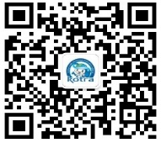
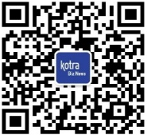
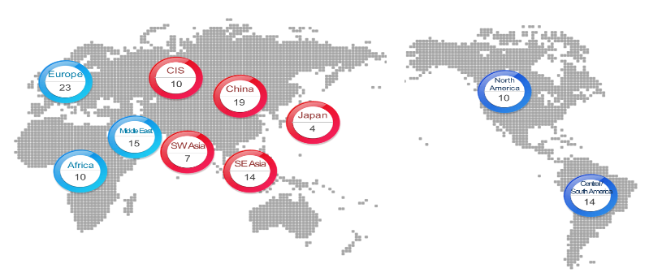
Contact information:
www.kotra.or.kr
+86 10 6410 6162
KotraChina @ Wechat
Kotra @ Wechat
KOTRA 介绍
主要业务
KOTRA(大韩贸易投资振兴公社) ——
站在韩国经济发展的中心，为韩国中小企业导航
支援海外经营
助力韩企“走出去”，帮助韩企在当地发展
推广韩国商品
推广韩国优秀商品，为韩企在全球建立商业合作关系
新
市场
+
新
工作
+
新
机会
提供商业信息
分析海外市场情况，发布海外投资经济信息
拓展海外业务
作为韩企的“驻外办”管理其客户，深度挖掘当地市场
吸引外商投资
营造良好的投资环境，吸引外商对韩投资
引荐韩国人才
帮助企业发掘韩国人才，支援韩国人才在海外就业
KOTRA在全球86个国(地区)设有10个地区总部，127个代表处，中国地区设有19个代表处。
重点项目
国际展会/博览会
- 2019 光州国际文化创意产业展
- 2019 老年医疗产业博览会
- 2019 全球食品博览会
- 2019 医疗博览会
- 2019 韩国美容博览会
- 2019 韩国机械展
- 2019 国际新再生能源专业展会
- 2019 韩国优秀商品展览
- 2019 韩国智能航空展示会
- 2019 韩国安城优质商品贸易洽谈会
- 2019 韩国快消品出口洽谈会
- 2019 韩国城南市优秀企业洽谈会

Slide 2
Contact information:
www.kotra.or.kr
+86 10 6410 6162
KotraChina @ Wechat
KotraBiznews @ Wechat
WHO WE ARE
WHAT WE DO
Korea Trade-Investment Promotion Agency, the Center of Economic Development in Korea
Export Support for SMEs
- Support by finding customers, running joint logistics between centers
- Helping exhibition participation assisting with international business trip.
Support for Overseas Expansion
- Supports Korean companies by marketing their advancement overseas easier and more convenient
KOTRA was launched in 1962. In 1990, KOTRA set up the representative office even before establishing diplomatic relations with China. Now, KOTRA has 19 head offices all around China, including Hong Kong.
Global Business Partnership
- Helps Korean SMEs & overseas global companies establish partnerships through international marketing support
- Opens the door to a future market for Korean technologies.
Investment Promotion
+
+
- Creating an attractive investment environment and supporting domestic investments by foreign companies.
NEW
Markets
NEW
Jobs
NEW
Opportunities
Trade & Investment Information
- Gathers, arranges and analyzes information on overseas markets
- Provides practical assistance for Korean companies.
Sustainable Growth Business
- Creating jobs, give hope to youth
- Lead the effort to create a friendly global village through global CSR activities.
MAIN EVENT
KOTRA is Located worldwide
There are 10 local head offices and 127 Korea Business Centers (KBCs) in 86 countries
- World Food Expo Korea 2019
- 2019 Medical Exhibition
- K-BEAUTY EXPO KOREA 2019
- Korea Machinery Fair 2019
- Soalr·Wind & Earth·Energy Trade Fair 2019
- 2019 Seoul Career Vision
- 2019 K-move Job Discovery
- 2019 G-FAIR KOREA (Korea Sourcing Fair)
- 2019 Korea-Guangzhou exhibition of international culture creative industry
- Korea-Hubei Economic cooperation Forum
- Korea-Tenjin Economic cooperation Plaza
- Korea-China Innovation Plaza
- Korea-China High-tech startup partnership
- 2019 MAMA association export conference
- Korea-China E-commerce Forum
- Korea-China Innovation Plaza
- KOTRA X SASA K-Beauty Pop Carnival
- 2019 Global Mobile Vision
- Korea-China Smart manufacturing collaboration plaza
CIS
10
China
19
Japan
SWAsia
4
7
SE Asia
14
Notes:
Main Event emoji name: Energy, Job, Forum, Innovation

